Slide 1

POKEMON GO CASE
TEAM 18
CLARA JOUY
GAGAN AGRAWAL
MARIE MASSERAN
CHARLES LE PROUX DE LA RIVIERE
XAVIER MELLEVILLE

Slide 2
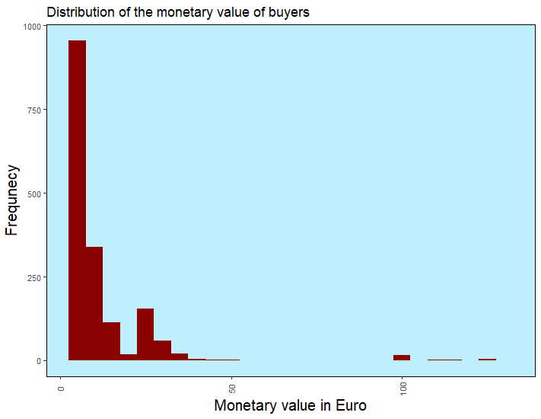
QUESTION 1:
1.1. Creation of the dataset
We see that, on 5,000 players, we have 4703 active players.
And for these active players we see that 20% of them received the fall boost package.
1.2. RFM Metrics and general profile
On this histogram, we can see the repartition of players by their monetary value (in €).
3rd quartile is at 9,99e, meaning that 75% of players spend less than €10 on the game.
Average purchase : €3.97
Only 36% of players buying.
Majority of small purchases < €4.99 for more than half of buyers
Enormous difference in buying behaviour
Notes:
n average, a customer spent 3,97€ on the app BUT
among the actif customers there is only 36% of people spending money on the app and the average purchase is 11€ with a maximum reaching 128€ but a median at 5€. THe majority of the purchase are small purchase but there are some heavy buyers. Standard deviation of 14€.

Slide 3
Profiling
Buyers
27
61% : 39%
64 Minutes
4489 Points
21%
413
338
507
439
Non Buyers
28
60% : 40%
57 Minutes
4437 Points
19%
806
803
623
774
Average age of Customers
Proportion of Male/Female
Average Duration Session
Average Experience
Percentage of Players who received fall bonus
Distribution by customer type
Walkers
Miscellaneous Players
Social Raiders
Catcher
Notes:
seniority has no impact on the proportion of buyers
almost not different except that:
social raiders has the highest proportion of buyers, miscellaneous has the lower

Slide 4
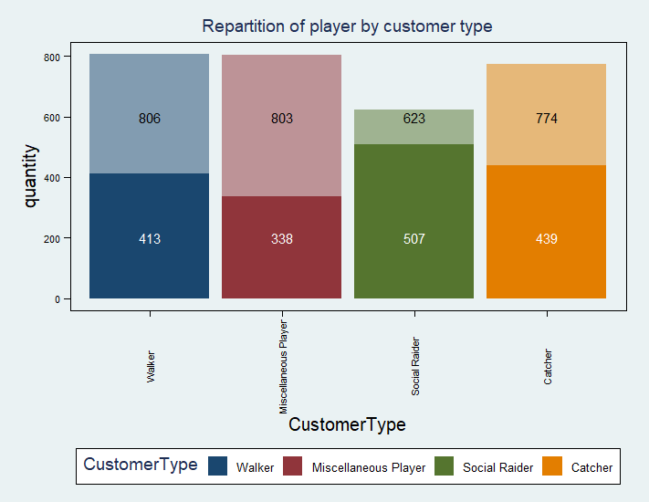

Slide 5
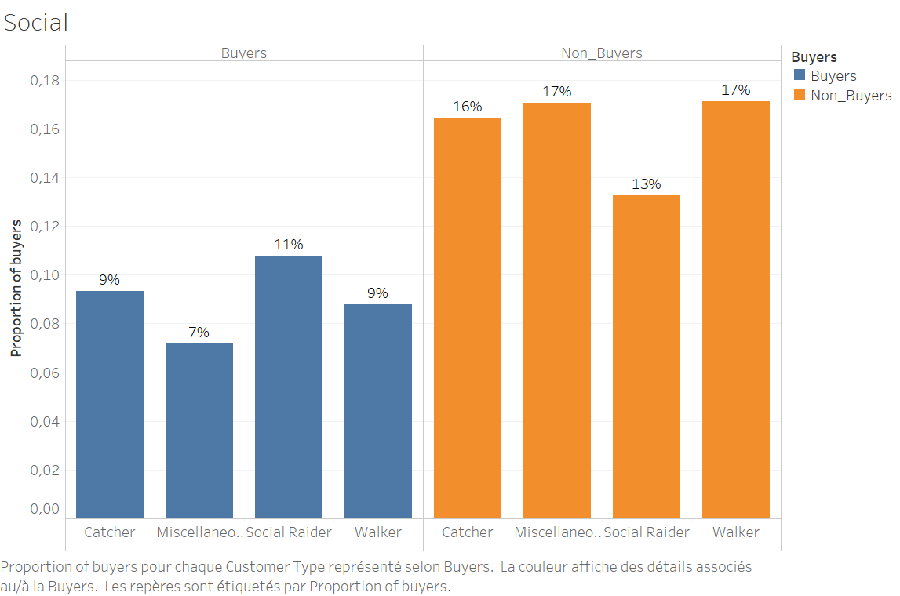
APPENDIX TO QUESTION 1.2
Repartition of buyers/non-buyers by customer type
Notes:
The main conclusion of this histogram is that social raiders seem to be more likely to belong to the buyers category.
About 50% of them are buyers, whereas in other categories this proportion nears 30%.

Slide 6
QUESTION 1:
1.3. Customer lifetime value: our assumptions
AC: €2.32
Retention Rate: 35%
24-month lifetime period -> average seniority: more than one year
Discount rate: 1.66% (ECB, 2018)
Monetary value: (specific for each customer)
Assuming these five elements, for active players we obtain an average lifetime value of €8.24 (and €14.45 for buyers)
Notes:
add the CLV for buying player
To compute customer lifetime value we needed to make assumptions.
In particular:
We found that AC for subscribe is in avg 2.17$ US for a common app, which gives, using the conversion rate of August 30th, an acquisition cost of 2.32$
Retention rate was computed as probability of a consumer who has paid in Summer 2018, to pay in Fall 2018. We obtain about 35% of retention rate.
We assume a 24-month life-time period, with a step of 4 month (6 steps)
We assume that our discount rate is the ECB composite cost-of-borrowing indicator of November 2018: 1,66%
#We found that AC for suscribe is in avg 2.17$ US for a common app (you have to subscribe to play to pokémon go)
#The acquisition cost for in-app purchase is not used here as it is not specified in the case that the app has done such marketing
#investments and the application advertisement is mainly working on Word of mouth.
cr=0.85713 # the converstion rate from US$ to on August, 30th 2018 (https://fr.exchange-rates.org/Rate/USD/EUR/30-08-2018)
#Thus we have
AC=2.71*cr

Slide 7
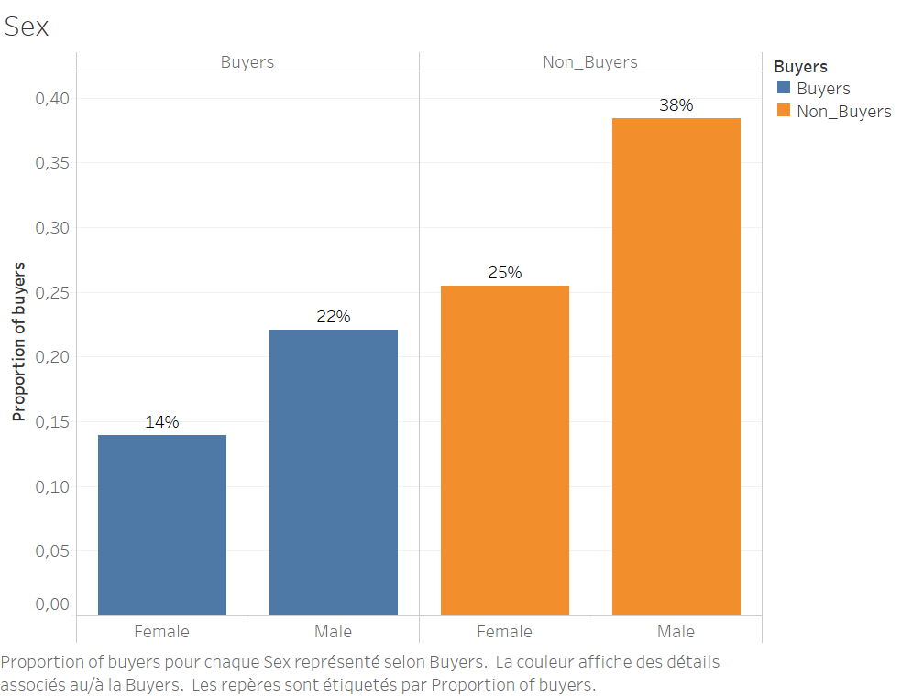
APPENDIX TO QUESTION 1
Repartition of buyers/non-buyers by sex
On this histogram, we can see that 60% of players are male, and that this repartition is still true when looking at buyers and non-buyers. Hence there is 40% female in both buyers and non-buyers categories.

Slide 8
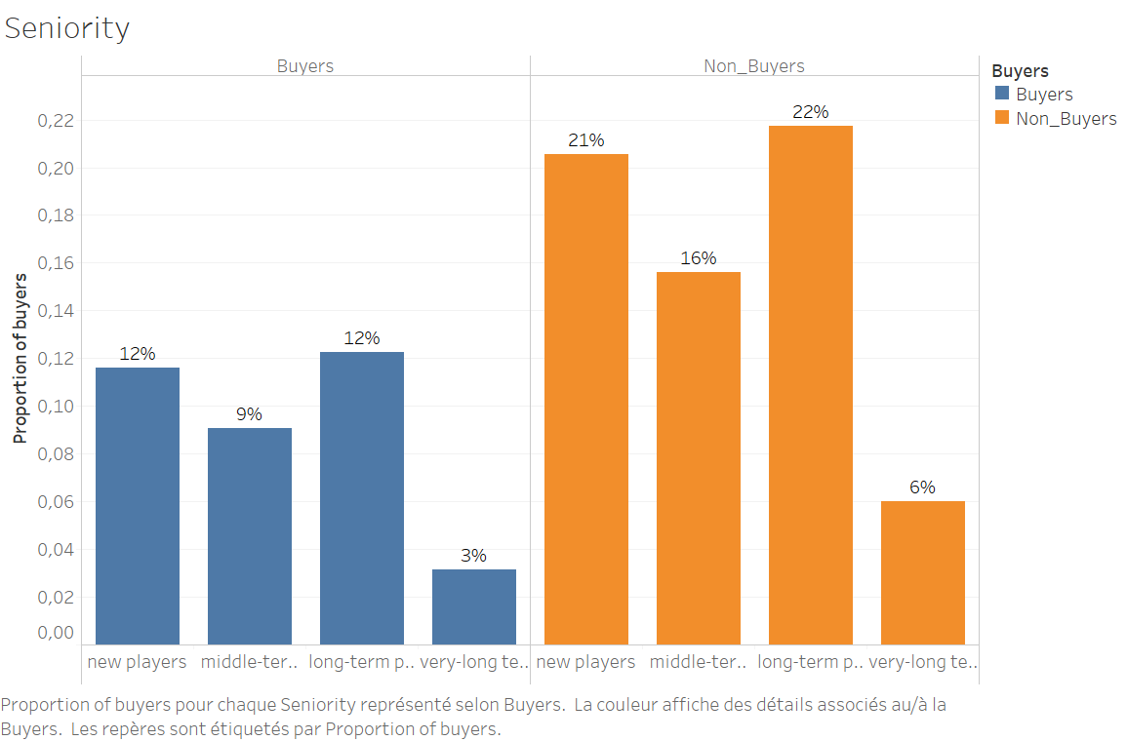
APPENDIX TO QUESTION 1
Repartition of buyers/non-buyers by seniority
The main conclusion of this histogram is that seniority is not a factor influencing the fact that players would belong to buyers and non-buyers categories, as every seniority gives the same proportion of « buyers » (about 30%)

Slide 9
Lifecycle grids build upon players
Recency = time since last session
Frequency = number of time the player connected

Slide 10
QUESTION 2:
Our selection of Lifecycle Grids:
GRID1: Proportion of buyers by customer type (RF based on sessions)
GRID2: Average monetary value by customer type (RF based on sessions)
GRID3: Total monetary value by customer type (RF based on transactions)
Notes:
How customers behaviour is evolving through time?
2 months after the 1st visit on the app, all customer types have a considerable decrease of active players.

Slide 11
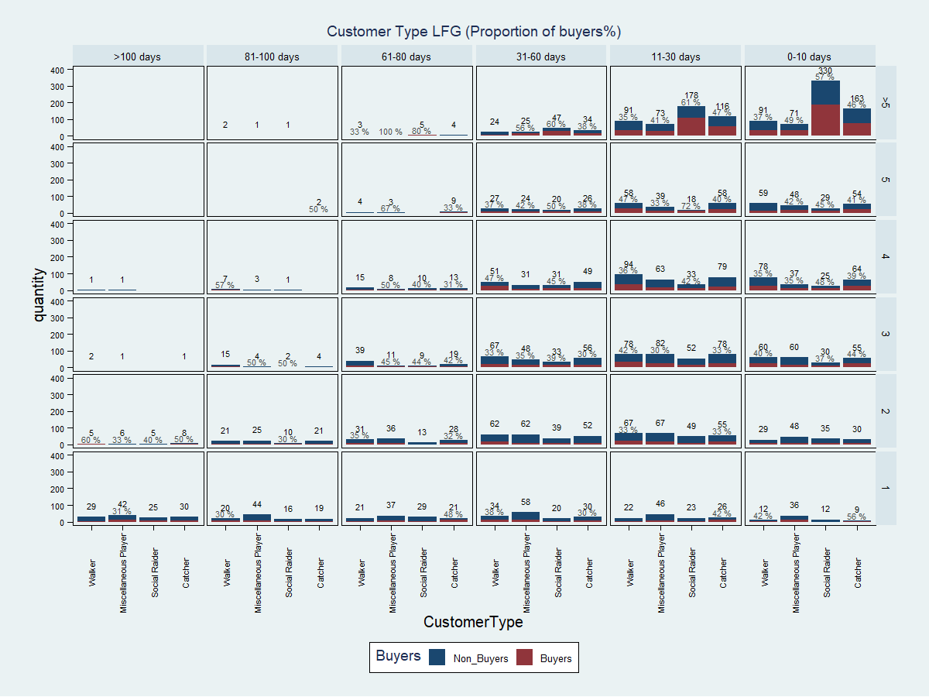
1st grid: Proportion of buyers by customer type (RF based on sessions)
social raiders are the most loyal
social raiders are more likely to buy
miscellaneous players often play only once
frequency has a slight positive impact on the proportion of buyers
Notes:
It is obvious that social raiders are both the most numerous to buy and the ones who are spending the most on the app so we might try to advertise toward them
Social raiders are the most loyal consumers. They play more frequently and recently than other customer types. And they have a huge proportion of buyers.
Just behind them, catchers are loyal too, but a bit less.
Miscellaneous players are the most numerous type of players to play only one time.
→ The proportion of buyers is almost the same for players who play a lot than players who play less.
Frequency of playing have a slight impact on buying behavior.

Slide 12
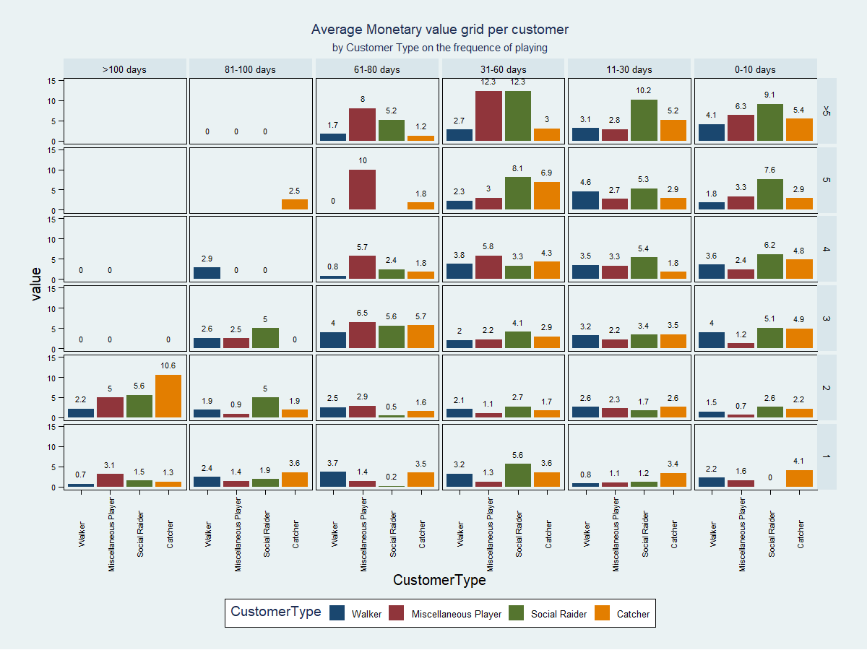
2nd grid : Average monetary value by customer type (RF based on sessions)
The miscellaneous players who stopped playing 2 months ago were spending much more money than the ones playing now
Similar behaviour for catchers
At the beginning of the summer, catchers spent more than others
Notes:
The miscellaneous players were used to spend much more on the app than now. We are losing those customers.
The catchers that have played the most recently are spending well less than the ones who stopped playing at the beginning of June.
In the starting of summer season catchers were spending more
Maybe during the summer there is more social raiders because customer have much time to spent on the application where during working time others categories are either more frequent or more likely to buy.

Slide 13
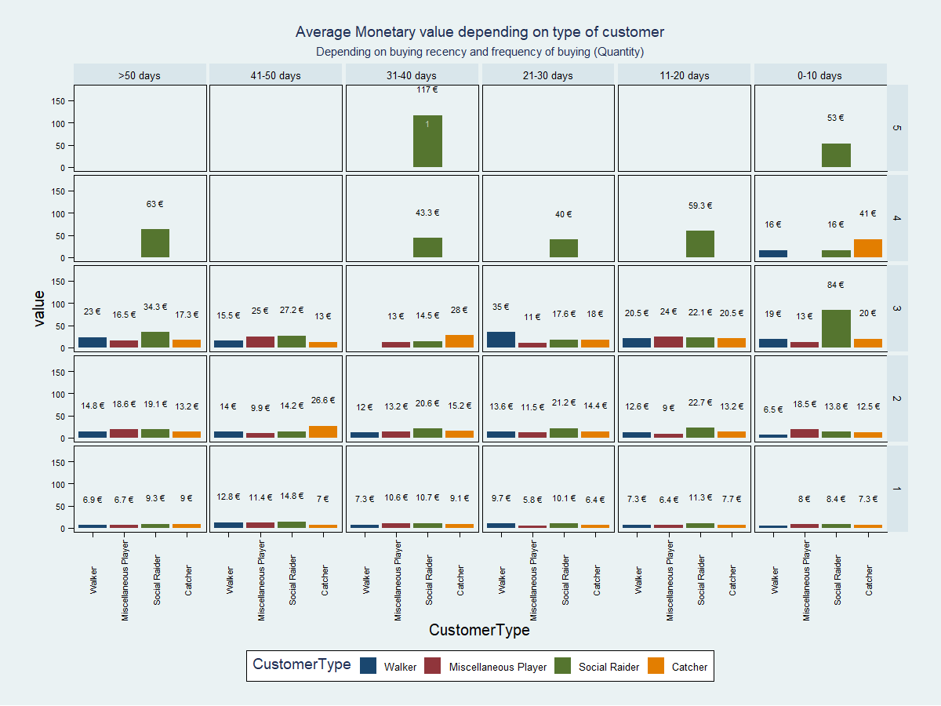
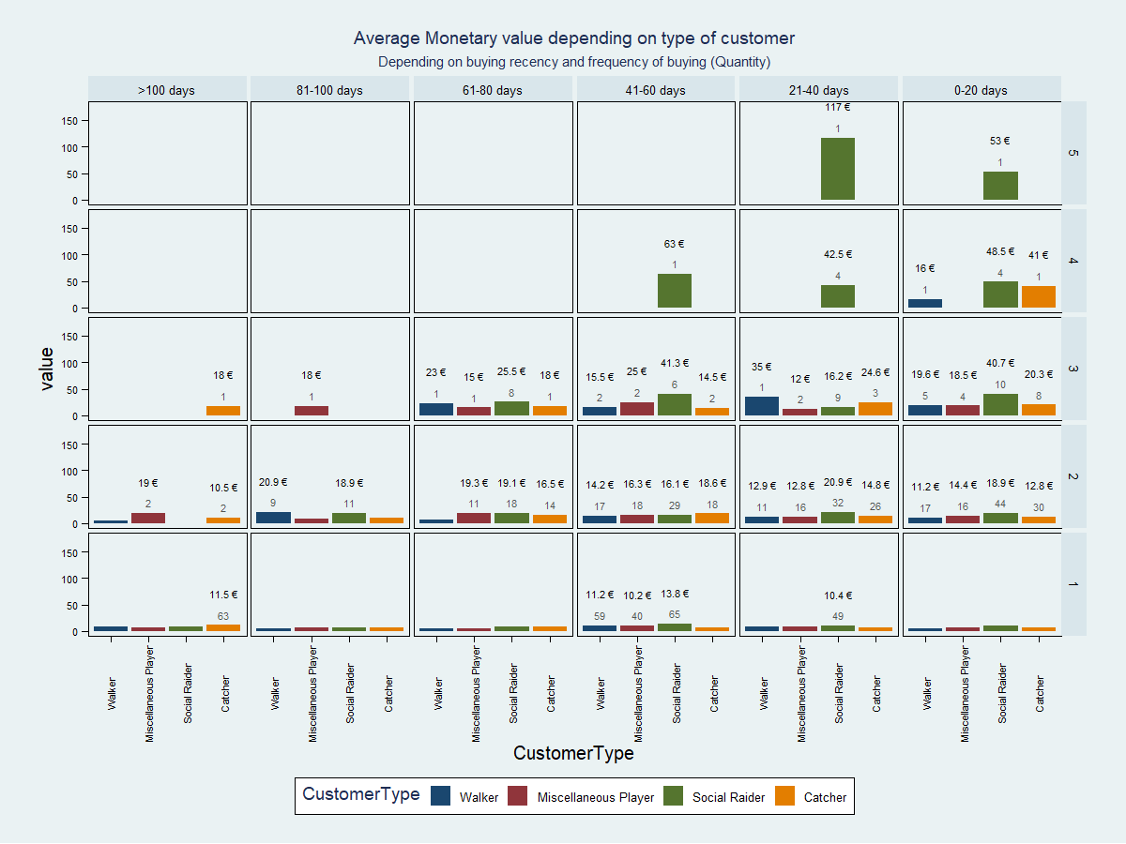
4th grid: comparison of average monetary value depending on type of customers within 2 scales
We change the scale of the recency to see if something changes. Nothing changes.

Slide 14
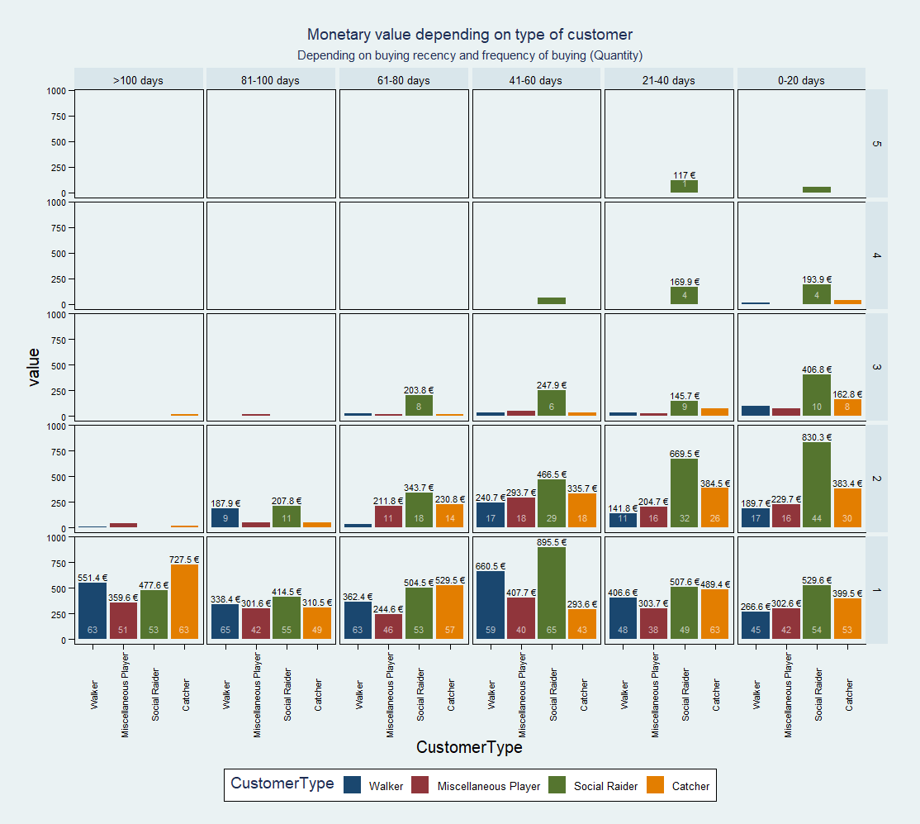
3rd grid: Total monetary value by customer type (RF based on transactions)
Most of the customers don’t buy more than three times. It is obvious that social raiders are both the most numerous to buy and the ones who are spending the most on the app so we might try to advertise toward them.
The problem of Pokémon Go is that it has a lot of customers that are buying once or twice and then stop buying. Social raiders seems to be the only type of customer that is ready to buy more than 3 times.
Notes:
It is obvious that social raiders are both the most numerous to buy and the ones who are spending the most on the app so we might try to advertise toward them

Slide 15
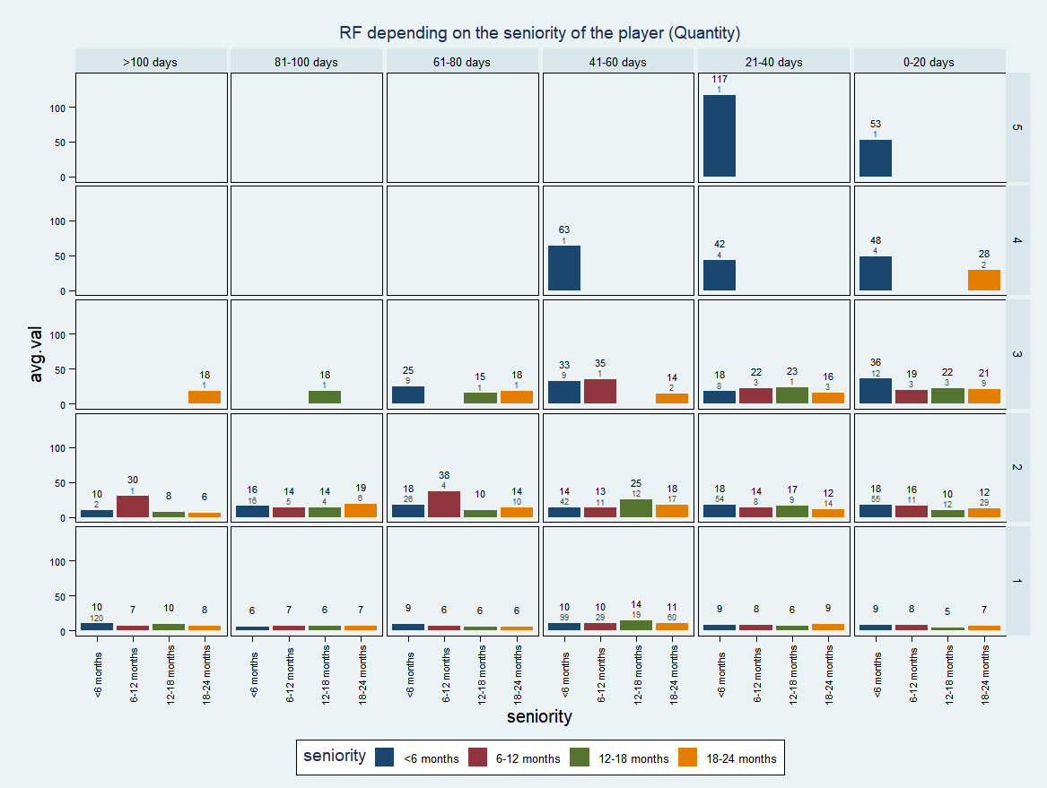
4th grid : Average monetary value by seniority (RF based on transactions)
New players are most likely to play recently and frequently

Slide 16
To summarize
Social raiders are the most loyal consumers
Frequency have a slight impact on buying behavior
We are losing the miscellaneous players and catchers as buyers as they used to spend much more on the app before than they spend now
Social raiders seem to be the only type of customer that is ready to buy more than 3 times
New Players are most likely to play recently and frequently
Limits of our data:
There are probably players who are playing not that frequently but over a long period and we cannot understand their buying patterns with focussing only on those for month :
→ there are players that play and pay during fall without being active customers during summer.
Notes:
Summarise the insight and put them on the grids

Slide 17
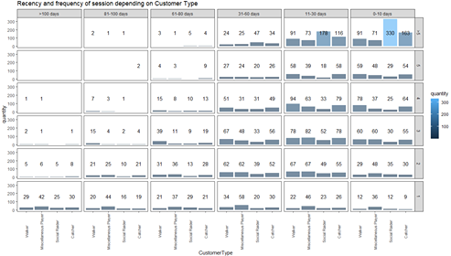
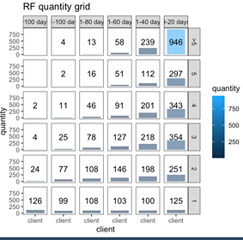
Appendix Question 2
Recency and frequency of session by Customer Type:
Recency and frequency depending on quantity:
Observations:
social raiders are the most loyal consumers. They play more frequently and recently than others customer types.
just behind them, catchers are loyal too, but a bit less.
Miscellaneous players are the most numerous type of players to play only one time.
Observations:
almost 1000 players have played more than 5 times during the last 20 days. They are our best players, our loyalest consumers.

Slide 18
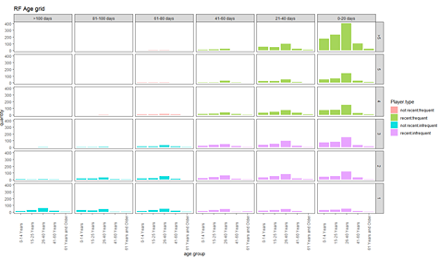
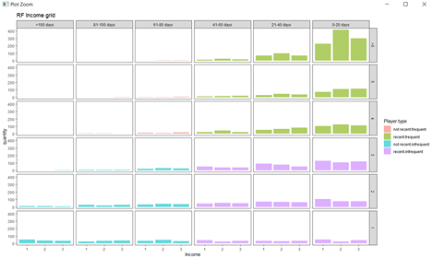
Appendix Question 2
Recency and frequency of session according to Age:
Recency and frequency of session according to Income:
Observations:
Players between 26-40 years old are more frequent and recent than players between 15-25 years
Observations:
Players with medium level of income (2) are the ones playing more frequently and recently
Players with high level of income (3) are just behind with high levels of recency and frequency
Players with low level of income (1) are a lot to stop playing after 1 to 3 parties

Slide 19
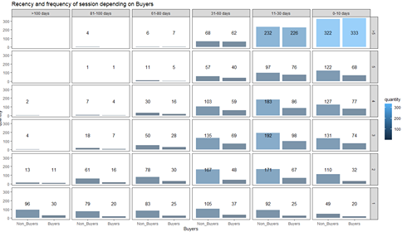
Appendix Question 2
Recency and frequency of session depending on Buyers
Observations:
buyers are mainly social raiders, who have recently subscribed (<1year), mid and long-term player with lower experience than average player
What about their income and customer type ?

Slide 20
QUESTION 3:
Calculate the average churn rate:
According to Niantic’s churn definition, being an active player during the summer who don’t perform any transaction during the fall, the average churn rate is 87,49%.
Find the significant factors that affect the churn rate:
We selected the following ones:
Monetaryvalue, Session recency,
Customer type as dummies (walker, catcher, social raider, miscellaneous), Seniority as dummies (Midtermplayer, Longtermplayer, Verylongtermplayer), Fallbonus
From our logistic regression on the churn pattern, here are our insights (by decreasing order of impact):
high monetary value → LESS likely to churn
fallbonus → LESS likely to churn
played recently → MORE likely to churn
social raider → MORE likely to churn
not a new player → LESS likely to churn
Notes:
The catchers that played the most recently (<10days ago)
Maybe during the summer there is more social raiders because customer have much time to spent on the application where during working time others categories are either more frequent or more likely to buy.
ACCURACY: precision(%churners predicted as churners) =90% ; PCC= 87%
LIFT: if we target the 10% of the customer who have the highest probability of churn according to our model with the fall bonus, we will reach 18% more real churner than if we had randomly distributed the fall bonus.
Fallbonus → only variable that we can impact with our strategy
Impact of fallbonus: reduces the probability to churn by 17%
We computed that it is more worthy to give the fallbonus to every player whatever its probability to churn because the missing value of the fallbonus was less important than the colst the cost loosing the customer.

Slide 21
Checking the correlation matrix
Before performing our regression, we compute the correlation Matrix. It gives us the correlated variables. We won’t use them as explanatory variables in our regression.
The list of the variables in the model:
Variables describing way of playing are highly correlated with the customer types so we drop them and just keep the customer types.
Same for the monetary value, lets keep only the CLV.
The buy.frequency is very correlated with recency and monetary value, we keep only the recency
We also keep only the sess.recency as it is highly correlated with the sess.frequency, which is also very correlated with the monetary value.
Notes:
Make the list

Slide 22
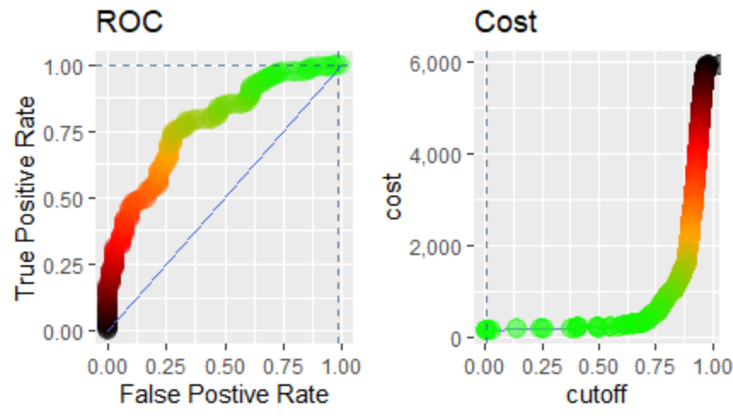
REPORT ONLY
We want to assess the performance of our logistic regression
Using the ROCR library, we compute the rates.

Slide 23
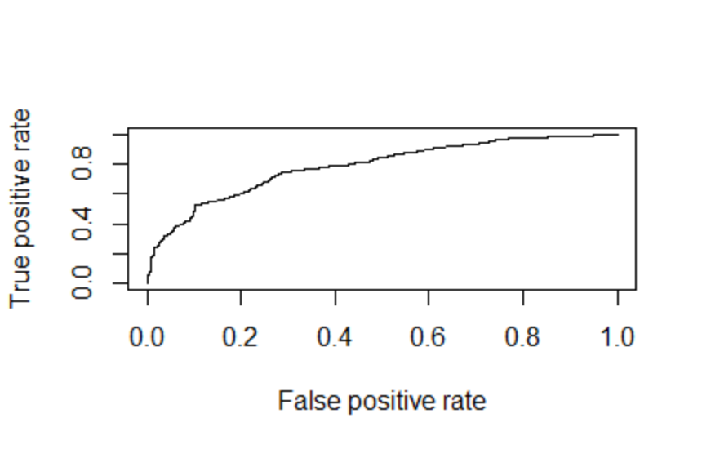
To assess accuracy, we use AUC
We want to prevent churn, as churners are costing us more than non-churners. Thus, in this graph, we want to maximize the area under the curve, which means to have the highest true positive rate possible.
The Area Under the Curve is 0.78, which is not so good and might be more precise. As we want to prevent churn as it costs us more than non churn, we want to maximize the Area Under the Curve
Let’s find a better cutoff.

Slide 24
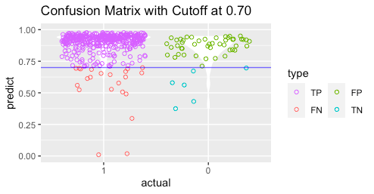
We assume a cost equivalent to the monetary value of our fallbonus, let's assume €2fp = 2
For a false negative (predicting that the customer will not churn while he/she will), we assume a cost equivalent to the loss of the CLV corresponding to the customer here we will consider the average CLV of non-churner.
→ The cutoff that minimize the cost of the model is 0.71
Conclusion of the performance & prediction: 86,84% of the predictions have been accurately classified

Slide 25
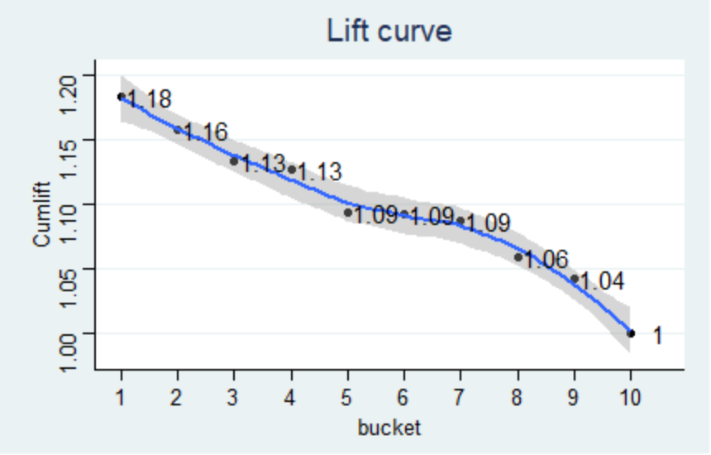
TALK ABOUT IT WITHOUT SHOWING THE SLIDES
Lift curve
This curve show that if we target the 10% of the customer who have the highest probability of churn according to our model with the fall bonus, we will reach 18% more real churner than if we had randomly distributed the fall bonus.

Slide 26
CONCLUSION:
To conclude this study, here are our strategy recommendations for Niantic:
The main objective is to prevent churn. Based on our analysis of the customer database, we found out recent and new players and social players are more likely to churn.
Niantic should focus its advertising campaign to get these customers back in the game.
On the other hand, we found out that the fallbonus have a real impact : it reduces the probability for a player to churn and as it does not cost a lot to Niantic, it is an interesting approach to give it once a year to every players.
Notes:
The catchers that played the most recently (<10days ago)
Maybe during the summer there is more social raiders because customer have much time to spent on the application where during working time others categories are either more frequent or more likely to buy.

Slide 27
How to target our relevant segment:
We want to focus on the first quartile (25%) of the best customers in the two segments we drew out in question 2: the social raiders and new players. After computations, the most current profile for the first quartile of both social raiders and new players is:
male, in average 27 years old, having a median income
To target these two segments, we propose, as examples, to prepare one special advertising campaign and to organize one event for each segment:
For new players: a discount campaign on certain products and a welcome week with experts giving advices and strategy to success in the game.
For social raiders, a media campaign insisting on the social and sport aspect of the game, and a special event “treasure hunt” rewarding the best players on an entire specific day (or week), as social raiders are the one playing the longest sessions.
Notes:
develop small marketing strategies for both segments
We want to focus on the 25% percentile of the best customer in the segment we drew out in question two : we see that they are in majority male who are 27 years old and a median income , as they are playing long term session so we could organize capturing a lot of pokémons and

Slide 28
appendix recommendations
Insights for managerial value:
→ develop social part of the app. Notifications when a player is around you, group challenges near cultural location
→ implement incentives for players to come back on the app after 2 months. Create renewed interest by unlocking new levels of future.

Slide 29
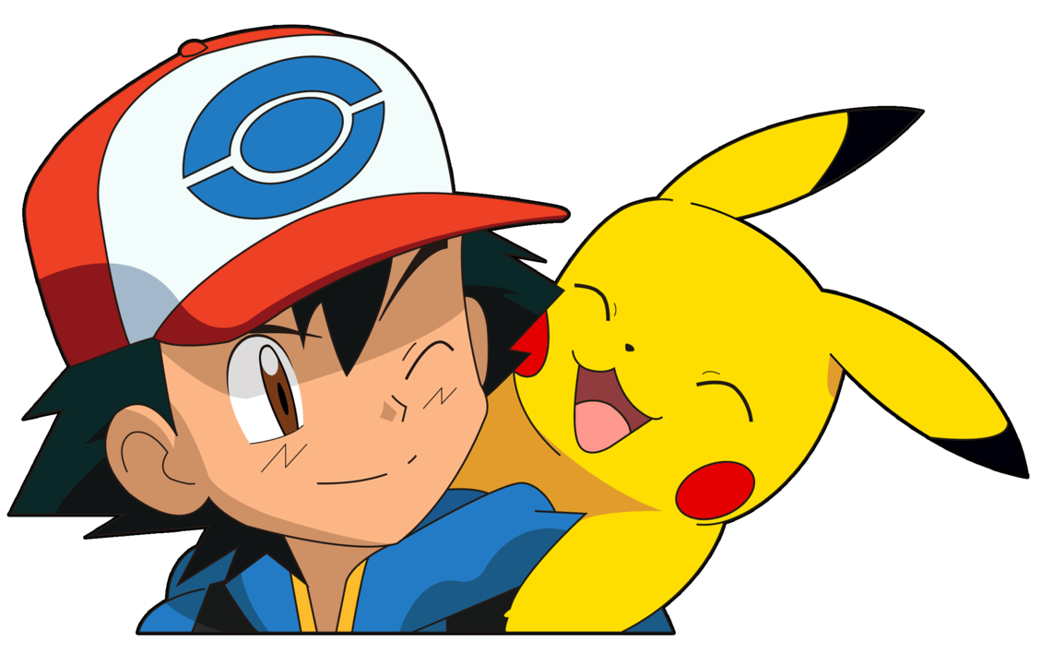
Thank you for listening !

